Slide 1
TSE6 - OpenCL
Part 3
Synchronization

Slide 2
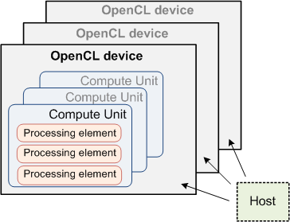
OpenCL Hardware Model
=core

Slide 3
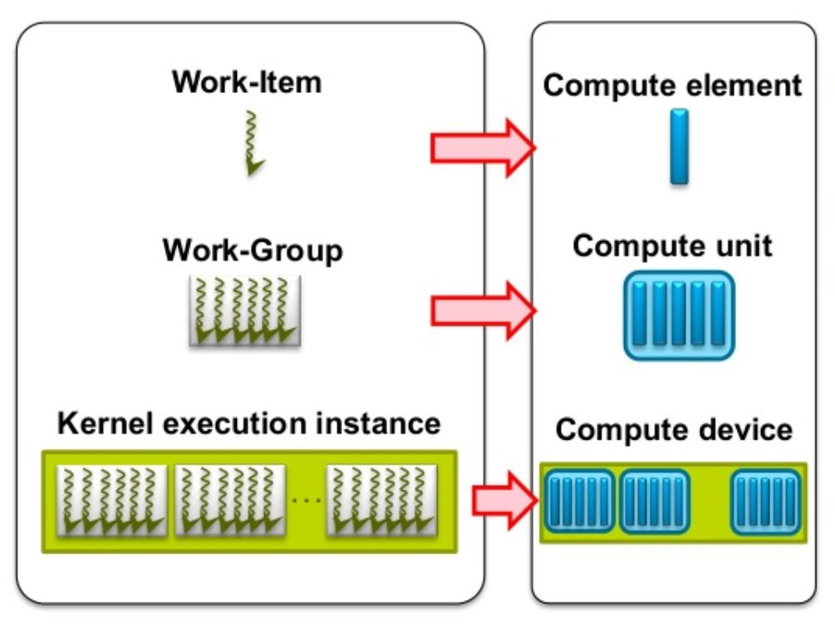
SW → HW mapping
Each Work Item (=Thread) is executed on a Processing Element (Compute Element)
Several Work Items can run on one Processing Element
Each Work Group is executed on a Compute Unit
Several Work Groups can run on one Compute Unit
Kernel is running on a Compute Device

Slide 4
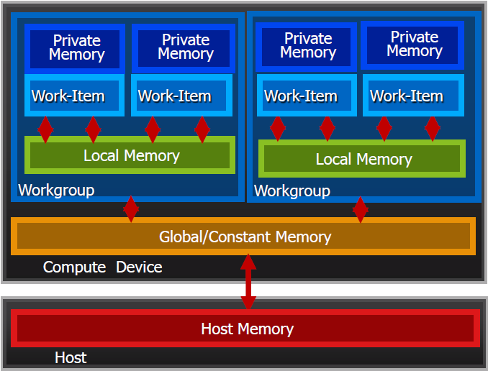
OpenCL SW Memory Model
In an OpenCL program, we can define several memory types
Private Memory
Per work-item
Local Memory
Shared within a workgroup
Global/Constant Memory
Shared between all workgroups
On the CPU
Host Memory
See also OpenCL Memory Spaces
Memory management is explicit
You must move data from host → global → local … and back

Slide 5
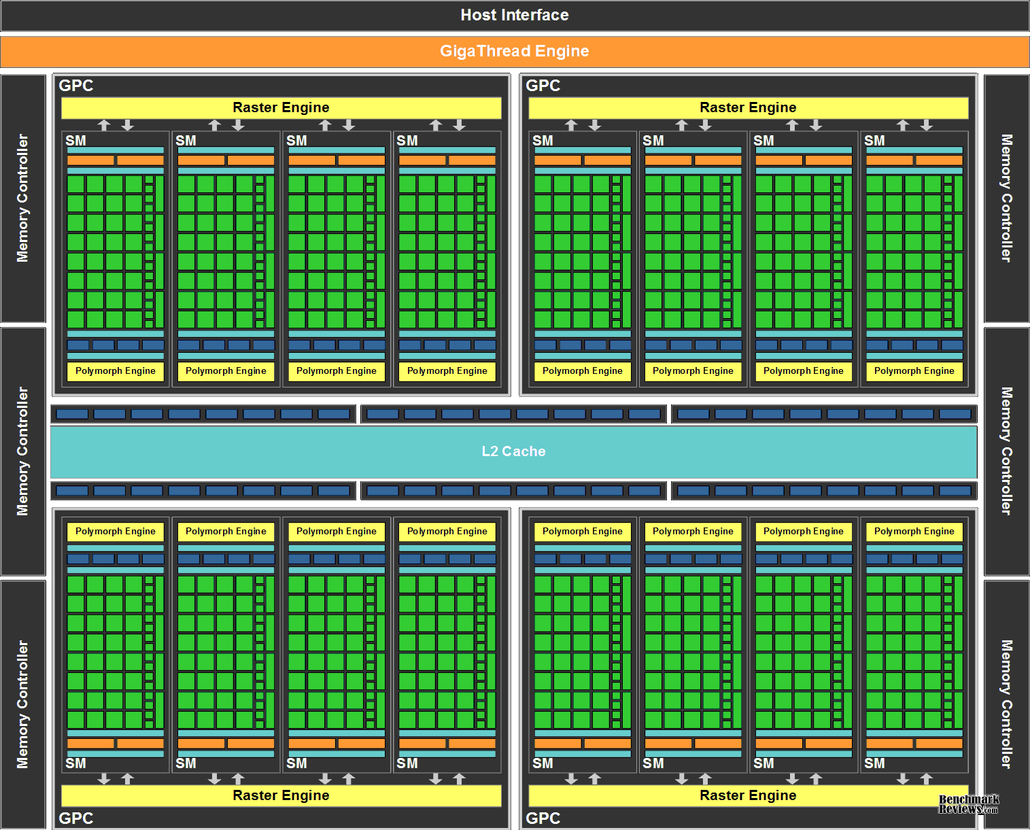
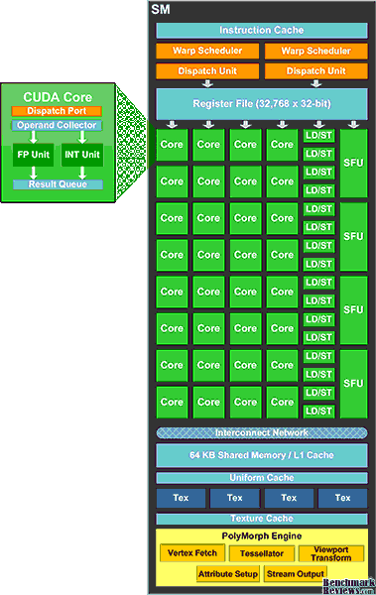
Example: nvidia Fermi memory
Private
memory
Compute Unit
Processing Element
Local
memory

Slide 6
OpenCL basic synchronization
For more complicated applications, usually some synchronization is needed
Two types of synchronization in OpenCL:
Wait on the host (until an queued command is finished)
Wait on the GPU (Work items inside a Workgroup)

Slide 7



clEnqueue… synchronization on host
Every device has a Command Queue
Contains commands that the host gives to the device
We have already seen a number of clEnqueue… functions that put a command in the queue:
clEnqueueWriteBuffer
clEnqueueReadBuffer
clEnqueueNDRangeKernel
......
clEnqueuRead/Write… have a blocking option (3d argument)
can make the CPU wait until the command is done
Blocking behavior of clEnqueueNDRangeKernel unspecified
may differ per implementation
GPU device
CPU
Context
Queue
Queue

Slide 8
clEnqueue… synchronization on device
When a queue is created (clCreateCommandQueue), we can specify whether it is in order, or not
In order (=default): all commands are executed one by one
Out of order execution mode: commands might be executed in other order
Mostly we use “in order” queues
When we call two (or more) enqueue-functions sequentially, then the commands will be synchronized:
clEnqueueWriteBuffer(...);
clEnqueueNDRangeKernel(...);
clEnqueueReadBuffer(...);
Kernel starts when WriteBuffer is finished
ReadBuffer starts when Kernel is finished
8

Slide 9
Wait for a queued command
Sometimes we want to wait on the host for a command to finish
For example when we want to measure the execution time
We can do this with clFinish(queue)
Will wait on the host until all the commands in the queue are finished
See slides week 2

Slide 10
Thread scheduling
Remember that
All threads in one Workgroup run on the same CU
Each thread runs on 1 PE
A CU has a limited number of PE’s (like 32 PE’s per CU)

Slide 11
Thread scheduling
There can be more threads in a Workgroup than there are PE’s in a CU
Suppose each CU has 32 PE’s, and a Workgroup has 128 Work Items
All Work Items of a Workgroup will run on the same CU
The first 32 threads will run in parallel on the CU
All these 32 threads are doing the same at the same time (or nothing)
When these are finished or waiting for memory IO, the next 32 threads will run
And so on…
Sometimes it is needed to let threads wait for each other

Slide 12
Example: vector reduction
Suppose we have a (long) array a, and we want to find the sum of all the elements
On a CPU:
int sum=0; for (int i=0; i<a.length; i++) sum += a[i];

Slide 13
Vector reduction on a CPU
a[0]
a[1]
a[2]
a[3]
a[4]
a[5]
a[6]
a[7]
+
+
Execution time linear with array length
Array length 8 → 7 steps
In general a.length-1 steps
How do we do this on GPU?
Above algorithm can not be parallelized directly, because it uses the same variable (sum) in all steps
+
+
+
+
+

Slide 14
Vector reduction on a GPU
On a GPU, we better add the values pair by pair, so we can do several additions in parallel
Still 7 additions needed, but now 8 values can be added in 3 steps
In general → ²log(a.length) steps
Much more efficient than linear
But take care that steps are done in the right order
a[0]
a[1]
a[2]
a[3]
a[4]
a[5]
a[6]
a[7]
+
+
+
+
+
+
+

Slide 15
Vector reduction on a GPU
Work division in Work Items, including copying global → shared:
WI0
WI1
WI2
WI3
WI4
WI5
WI6
WI7
a[0]
a[1]
a[2]
a[3]
a[4]
a[5]
a[6]
a[7]
Global Memory
s[0]
s[1]
s[2]
s[3]
s[4]
s[5]
s[6]
s[7]
Shared Memory
+
+
+
+
+
+
+

Slide 16
GPU Simulation Play
Steps for Work Item x:
Ask Memory Controller to get value from address x in Global Mem
Wait for Memory Controller to return
Write value in circle x
If your x is a multiple of 2 (else do nothing):
Read the values in circles x and x+1
Add these values and store the result in circle x
If your x is a multiple of 4 (else do nothing):
Read the values in circles x and x+2
Add these values and store the result in circle x
If your x is a multiple of 8 (else do nothing):
Read the values in circles x and x+4
Add these values and store the result in circle x
Write the result on the paper with number 0 and put it in the box

Slide 17
Reduction kernel 1: Interleaved Addressing
Values (Global Memory)
10 | 1 | 8 | -1 | 0 | -2 | 3 | 5 | -2 | -3 | 2 | 7 | 0 | 11 | 0 | 2
Copy from Global to Local
0
1
2
3
4
5
6
7
8
9
10
11
12
13
14
15
Values (Local Memory)
10 | 1 | 8 | -1 | 0 | -2 | 3 | 5 | -2 | -3 | 2 | 7 | 0 | 11 | 0 | 2
Step 1
Stride 1
Local IDs
Values
Local IDs
Values
Local IDs
Values
Local IDs
0
2
4
6
8
10
12
14
11 | 1 | 7 | -1 | -2 | -2 | 8 | 5 | -5 | -3 | 9 | 7 | 11 | 11 | 2 | 2
Step 2
Stride 2
0
4
8
12
18 | 1 | 7 | -1 | 6 | -2 | 8 | 5 | 4 | -3 | 9 | 7 | 13 | 11 | 2 | 2
Step 3
Stride 4
0
8
24 | 1 | 7 | -1 | 6 | -2 | 8 | 5 | 17 | -3 | 9 | 7 | 13 | 11 | 2 | 2
Step 4
Stride 8
0
41 | 1 | 7 | -1 | 6 | -2 | 8 | 5 | 17 | -3 | 9 | 7 | 13 | 11 | 2 | 2
Copy result back to Global
0
41

Slide 18
Reduction kernel 1 (yet incorrect)
__kernel void reduction(__global int *gdata) {
__local int sdata[128];
unsigned int tid = get_local_id(0);
unsigned int gid = get_global_id(0);
// copy int’s from Global to Local memory
sdata[tid] = gdata[gid];
// do reduction in Local memory
for(unsigned int s=1; s < get_local_size(0); s *= 2) {
if (tid % (2*s) == 0){ // if ThreadID is a multiple of 2*s
sdata[tid] += sdata[tid + s];
}
}
// write result for this block to global mem
if (tid == 0) gdata[get_group_id(0)] = sdata[0];
}

Slide 19
Dynamically allocating local memory
Problem 1 with previous solution
Local array is defined statically
__local int sdata[128];
The size of sdata (128) is hard coded in this way
can not easily be changed (array definition does not allow to specify size with a variable)
We can also define the Local Memory dynamically:
__kernel void reduction1(__global int *gdata, __local *sdata) {
Then the second argument of the kernel has to be set like:
clSetKernelArg(kernel, 1, 128*sizeof(int), NULL);
Or, more general:
clSetKernelArg(kernel, 1, WORKGROUP_SIZE*sizeof(int), NULL);

Slide 20
Synchronizing the threads
Problem 2 with the previous algorithm:
Not all threads in a Workgroup run at the same time
Example:
on a CU with 8 PE’s, threads 0, 2, 4 and 6 might run first, and when they are finished, then threads 8, 10, 12 and 14 run on the same CU
This means that thread 0 could be finished before threads 8, 10, 12, 14 have run → producing wrong answer
Synchronization of the threads is needed!

Slide 21
barrier
OpenCL offers a special function for thread synchronization
Can be used only inside a kernel
barrier(CLK_LOCAL_MEM_FENCE);
All threads of one Workgroup wait here for each other until all previous Local Memory operations have been finished
barrier(CLK_GLOBAL_MEM_FENCE);
Similar for Global Memory operations
In the previous kernel, synchronization needs to be added at the moments indicated by the green arrows in slide 20
Or maybe not all of them are needed?

Slide 22



Reducing big arrays
For long arrays, we split the work up in Workgroups
Every Workgroup calculates the sum of its own part of the array (level 0)
Afterwards, all the sub-results are added by a new kernel call (level 1) to find the total
For very long arrays, this has to be done in more than 2 levels
11
14
11
14
9
11
14
11
14
11
14
11
7
14
11
14
11
14
25
25
25
2
25
25
25
25
Level 0:
8 workgroups
3 1 7 0 4 1 6 3
Level 1:
1 workgroup
4 7 5
11 14
25

Slide 23
Reducing big arrays
Suppose that:
The array has 1024 elements
Every Workgroup has 128 threads
The array is in Global Memory
Every Workgroup calculates the sum of 128 array-elements
There are 8 Workgroups needed to handle all 1024 elements
First, every thread copies one element from Global to Local memory
Each Workgroup then needs 7 steps to reduce 128 elements to their sum
Every Workgroup generates one element, so we have 8 results
The same kernel has to be called again to sum up these 8 values
Only 3 extra steps are needed to add these 8 values

Slide 24
Reducing very big arrays
Suppose that we have a bigger array:
The array has 1024*1024 elements
Every Workgroup has 128 threads
The array is in Global Memory
Every Workgroup calculates the sum of 128 array-elements
There are 8192 Workgroups needed to handle all elements
Every Workgroup generates one result, so we get 8192 values in total
The same kernel has to be called again to sum up these 8192 values
Now 64 Workgroups are needed, giving 64 results
The same kernel has to be called for the 3^{d} time to sum up these 64 values
So we must call the kernel 3 times
If array bigger than 2M, then we must call the kernel 4 times, etc

Slide 25
Optimizing the kernel

Slide 26
Kernel 1 is not optimal
When we allocate the Local Memory dynamically, and add the right barriers, then kernel1 is OK, but by far not optimal
One problem is that consecutive threads are doing very different things:
In the beginning, all threads are copying one value, which is fine
In step 1, thread 0, 2, 4, 6, 8 10, 12 and 14 are working, but threads 1, 3, 5, 7, 9, 11, 13, and 15 are idle (but still occupying a PE)
This is called Divergence and turns out to be quite inefficient
It is better if consecutive threads are doing the same thing as much as possible → kernel2

Slide 27
Reduction kernel 2: Less divergence
Values (Global Memory)
10 | 1 | 8 | -1 | 0 | -2 | 3 | 5 | -2 | -3 | 2 | 7 | 0 | 11 | 0 | 2
Copy from Global to Local
0
1
2
3
4
5
6
7
8
9
10
11
12
13
14
15
Values (Local Memory)
10 | 1 | 8 | -1 | 0 | -2 | 3 | 5 | -2 | -3 | 2 | 7 | 0 | 11 | 0 | 2
Step 1
Stride 1
Local IDs
Values
Local IDs
Values
Local IDs
Values
Local IDs
0
1
2
3
4
5
6
7
11 | 1 | 7 | -1 | -2 | -2 | 8 | 5 | -5 | -3 | 9 | 7 | 11 | 11 | 2 | 2
Step 2
Stride 2
0
1
2
3
18 | 1 | 7 | -1 | 6 | -2 | 8 | 5 | 4 | -3 | 9 | 7 | 13 | 11 | 2 | 2
Step 3
Stride 4
0
1
24 | 1 | 7 | -1 | 6 | -2 | 8 | 5 | 17 | -3 | 9 | 7 | 13 | 11 | 2 | 2
Step 4
Stride 8
0
41 | 1 | 7 | -1 | 6 | -2 | 8 | 5 | 17 | -3 | 9 | 7 | 13 | 11 | 2 | 2
Copy result back to Global
0
41

Slide 28
Reduction kernel 2
Replace the for-statement:
for(unsigned int s=1; s < get_local_size(0); s *= 2) {
if (tid % (2*s) == 0){ // if ThreadID is a multiple of 2*s
sdata[tid] += sdata[tid + s];
}
...
By:
for(unsigned int s=1; s < get_local_size(0); s *= 2) {
int index = 2*s*tid;
if (index<get_local_size(0)){
sdata[index] += sdata[index + s];
}
...

Slide 29
Kernel 2 is not optimal
After the first step (copying from Global to Local), half or more of the threads in a Workgroup are idle
With kernel1, threads 1, 3, 5, 7, 9, 11, 13, and 15 are idle in step1
With kernel2, threads 8, 9, 10, 11, 12, 13, 14, and15 are idle in step 1
In step 2 and later, even more threads are idle
We can avoid this (a bit) by combining the copy step in the beginning with the first addition step
The Workgroups can be made half as big then

Slide 30
Reduction kernel 3: Less idle threads
Values (Global Memory)
10 | 1 | 8 | -1 | 0 | -2 | 3 | 5 | -2 | -3 | 2 | 7 | 0 | 11 | 0 | 2
Step 1 (copy+add)
Stride 1
Local IDs
Values
Local IDs
Values
Local IDs
Values
Local IDs
0
1
2
3
4
5
6
7
11 | 1 | 7 | -1 | -2 | -2 | 8 | 5 | -5 | -3 | 9 | 7 | 11 | 11 | 2 | 2
Step 2
Stride 2
0
1
2
3
18 | 1 | 7 | -1 | 6 | -2 | 8 | 5 | 4 | -3 | 9 | 7 | 13 | 11 | 2 | 2
Step 3
Stride 4
0
1
24 | 1 | 7 | -1 | 6 | -2 | 8 | 5 | 17 | -3 | 9 | 7 | 13 | 11 | 2 | 2
Step 4
Stride 8
0
41 | 1 | 7 | -1 | 6 | -2 | 8 | 5 | 17 | -3 | 9 | 7 | 13 | 11 | 2 | 2
Copy result back to Global
0
41

Slide 31
Useful links
A similar kind of reduction in OpenCL (although not the same): http://developer.amd.com/resources/documentation-articles/articles-whitepapers/opencl-optimization-case-study-simple-reductions/
Reduction in CUDA (we discussed kernel #1, #2 and #4)): http://developer.download.nvidia.com/compute/cuda/1.1-Beta/x86_website/projects/reduction/doc/reduction.pdf
About dynamical Local Memory allocation: http://www.openclblog.com/2014/10/allocating-local-memory.html

